Slide 1
COMP 520 - Compilers
Lecture 11 – Recap of Contextual Analysis in PA3

Slide 2
Midterm 1 Results
Maximum: 100 (18)
Median: 95.5
Mean: 94.8
COMP 520: Compilers – S. Ali

Slide 3
Midterm 1 Results (2)
Question 2: comparable to previous midterm
Question 3: was exactly from a previous midterm
Question 4: was harder than a previous midterm
COMP 520: Compilers – S. Ali

Slide 4
Midterm 1 Results (3)
Question 2: comparable to previous midterm
Question 3: was exactly from a previous midterm
Question 4: was harder than a previous midterm
In comparison, the average for this class was more than 10 points higher than an earlier class
COMP 520: Compilers – S. Ali

Slide 5
Upcoming Code Generation
We will have a few in-class demos where we SHOW how a processor works.
Will show visualizations of what will happen in a program in some live demos.
COMP 520: Compilers – S. Ali

Slide 6
LL(1), 4 Statement Cases
this(.id)*(= Expr ;| [Expr] = Expr ; | ( ArgList? ) ; )
| boolean id = Expr ;
| id ( .id(.id)*(=Expr;|[Expr]=Expr;|(ArgList?);)
| =Expr; | (ArgList?);
| [(] id = Expr;|Expr] = Expr;)
| id = Expr;
)
Was missing from earlier slide
COMP 520: Compilers – S. Ali

Slide 7
Please note: miniJava
miniJava does not have typecasting nor automatic conversions.
miniJava does not allow boolean $×$ int $×$ Op
COMP 520: Compilers – S. Ali

Slide 8
Programming Assignment 3
Identification and Type-Checking
COMP 520: Compilers – S. Ali

Slide 9
You own the ASTs for PA3 and forward
Can add, edit, remove any ASTs you want.
COMP 520: Compilers – S. Ali

Slide 10
Strategy
Two separate Visitor implementations
First identification, then type-checking
COMP 520: Compilers – S. Ali

Slide 11
Strategy (2)
Two separate Visitor implementations
First identification, then type-checking
It is possible to do this in one AST traversal. Optional, is a PA5 extra credit item.
COMP 520: Compilers – S. Ali

Slide 12
Identification Goal
Every Identifier gets a “decl” field added, of type Declaration
We want to locate where every identifier is declared.
Could be a VarDecl, ParameterDecl, MemberDecl, ClassDecl
COMP 520: Compilers – S. Ali

Slide 13
Why?
Why is it that only syntax checking, and context checking is enough for ensuring an input program is correct?
COMP 520: Compilers – S. Ali

Slide 14
Today
First, we will cover type-checking
Then, we will page identification back in
Goal: Learn how to properly ensure type checking is implemented, and go backwards to determine how to enable type checking with identification.
COMP 520: Compilers – S. Ali

Slide 15
PA3 – Type Checking
COMP 520: Compilers – S. Ali

Slide 16
Type-Checking Table
In miniJava, type order does not matter, so A$×$B$×$op is the same as B$×$A$×$op
This means we can simplify our TypeChecking table.
COMP 520: Compilers – S. Ali

Slide 17
miniJava – Types must match
For miniJava, the types must match. There is no automatic type conversions nor manual typecasting.
COMP 520: Compilers – S. Ali

Slide 18
miniJava – Types must match
For miniJava, the types must match. There is no automatic type conversions nor manual typecasting.
Does this mean we can use a REALLY simple type-checking table where both types must match, and the result type is that type?
COMP 520: Compilers – S. Ali

Slide 19
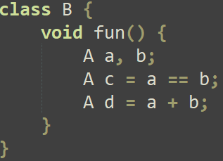
miniJava – Types must match
Does this mean we can use a REALLY simple type-checking table where both types must match, and the result type is that type?
Still need to formally clarify Type rules.
COMP 520: Compilers – S. Ali

Slide 20
Type-Checking Table (2)
Type Checking Rules
Operand Types | Operand | Result
boolean $×$ boolean | &&, || | boolean
int $×$ int | >, >=, <, <= | boolean
int $×$ int | +, -, *, / | int
$$α×α$$ | ==, != | boolean
int | (Unary) - | int
boolean | (Unary) ! | boolean
COMP 520: Compilers – S. Ali

Slide 21
ClassType
If two objects are both ClassType, are they comparable?
COMP 520: Compilers – S. Ali

Slide 22
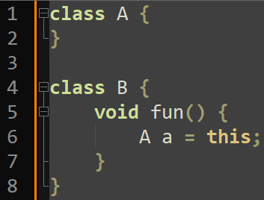
ClassType (No polymorphism in miniJava)
If two objects are both ClassType, are they comparable?
No, the underlying Identifier text must match.
Why is this enough?
COMP 520: Compilers – S. Ali

Slide 23
What type is ArrayType?
Recall: new int[4]
This expression is of ArrayType(IntType)
Thus, it can only be assigned to variables of type ArrayType(IntType)
IntType is shorthand for: BaseType( TypeKind.INT )
COMP 520: Compilers – S. Ali

Slide 24
What type is ArrayType? (2)
For array types:
First: Are both types ArrayType?
Second: Do the element types match? (Recursion)
Recursion needed to match ArrayType of ArrayType of ArrayType of ClassType.
COMP 520: Compilers – S. Ali

Slide 25
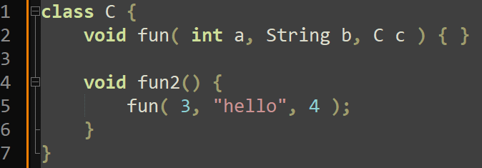
Type-Checking Methods
Scoped Identification only uses context and identifiers. Therefore, overloading methods by parameter types/counts is not allowed in miniJava.
COMP 520: Compilers – S. Ali

Slide 26
Type-Checking Methods (2)
As such, make sure there is an expression for every parameter, and that the types match.
COMP 520: Compilers – S. Ali

Slide 27
Type Errors
The ErrorType is compatible with ALL other types, and the result type is always another ErrorType and this does not cause an error to be reported.
If a type is not allowed in an operation with another type, then the result type is an ErrorType.
COMP 520: Compilers – S. Ali

Slide 28
Unsupported Type
The UNSUPPORTED type is not compatible with any type (including itself) and causes an error to be reported. The result type will be ErrorType.
Make sure String’s type is UNSUPPORTED, otherwise String can be initialized with new String(), which is not implemented in miniJava.
COMP 520: Compilers – S. Ali

Slide 29
Unsupported Type (2)
The String predefined class is an UNSUPPORTED type.
String is not supported in miniJava, but available to be implemented as a part of PA5.
We need String to be able to declare the main method.
COMP 520: Compilers – S. Ali

Slide 30
Unsupported Type (3)
UNSUPPORTED$×$ErrorType
Question: should an error be reported?
COMP 520: Compilers – S. Ali

Slide 31
Unsupported Type (4)
UNSUPPORTED$×$ErrorType does not need to be reported (only way ErrorType exists is if an error was reported earlier anyway).
But it can be reported if you want to report an extra error where String is utilized.
COMP 520: Compilers – S. Ali

Slide 32
Type-Checking Strategy (1)
Implement a TypeChecking Visitor that uses a TypeDenoter return type.
Visiting a node synthesizes a TypeDenoter for that type.
COMP 520: Compilers – S. Ali

Slide 33
Traverse an AST bottom-up?
Not talking about SR parsing here.
We’re done with Parsing and Syntactic Analysis
COMP 520: Compilers – S. Ali

Slide 34
Traverse an AST bottom-up? (2)
The leaf nodes of an AST are visited first.
Why?
COMP 520: Compilers – S. Ali

Slide 35
Traverse an AST bottom-up? (2)
The leaf nodes of an AST are visited first.
If I have an expression: int b = 20 + 5 * 100
I don’t know the type of that expression just by looking at the “Expression” AST
COMP 520: Compilers – S. Ali

Slide 36
Traverse an AST bottom-up? (3)
If I have an expression: int b = 20 + 5 * 100
I don’t know the type of that expression just by looking at the “Expression” AST
COMP 520: Compilers – S. Ali

Slide 37
Traverse an AST bottom-up? (3)
If I have an expression: int b = 20 + 5 * 100
S
E
$
T
Op +
T
20
(
E
)
T
Op *
T
5
100
COMP 520: Compilers – S. Ali

Slide 38
Traverse an AST bottom-up? (4)
If I have an expression: int b = 20 + 5 * 100
S
E
$
INT
INT
T
Op +
T
20
(
E
)
T
Op *
T
INT
INT
5
100
COMP 520: Compilers – S. Ali

Slide 39
Traverse an AST bottom-up? (5)
If I have an expression: int b = c + d * e
S
E
$
T
Op +
T
c
(
E
)
T
Op *
T
d
e
COMP 520: Compilers – S. Ali

Slide 40
Traverse an AST bottom-up? (5)
If I have an expression: int b = c + d * e
S
How can we determine the type of c, d, e (and b)?
E
$
T
Op +
T
c
(
E
)
T
Op *
T
d
e
COMP 520: Compilers – S. Ali

Slide 41
Type-Checking Strategy (2)
Implement a TypeChecking Visitor that uses a TypeDenoter return type.
Visiting a node synthesizes a TypeDenoter for that type.
Create a method, input is the two TypeDenoters, (or one for Unary), and output is the resultant TypeDenoter.
COMP 520: Compilers – S. Ali

Slide 42
Type-Checking Strategy (3)
Implement a TypeChecking Visitor that uses a TypeDenoter return type.
Visiting a node synthesizes a TypeDenoter for that type.
Create a method, input is the two TypeDenoters, (or one for Unary), and output is the resultant TypeDenoter.
Or create a table, but that would have a lot of null entries.
COMP 520: Compilers – S. Ali

Slide 43
Type-Checking Strategy (2)
Ensure index expressions are integers
A[ IndexExpr ]
Ensure condition expressions in if/while are Boolean
if( CondExpr ) / while( CondExpr )
Ensure operands are compatible, and return the appropriate type when visiting that BinExpr/UnaryExpr
A a;
a = 3 + a;
COMP 520: Compilers – S. Ali

Slide 44
Back to Identification
COMP 520: Compilers – S. Ali

Slide 45
Scoped Identification Stack
Some languages do not let you access all members in a stack.
This is not the case for Java.
COMP 520: Compilers – S. Ali

Slide 46
Scoped Identification Stack (2)
Some languages do not let you access all members in a stack.
This is not the case for Java.
Actually, this is mostly not a case for a lot of languages
For example, std::priority_queue says you can’t iterate through it, but you can just get the underlying container.
COMP 520: Compilers – S. Ali

Slide 47
Upcoming Side Note*
As we will see, many language constraints like public/private are only enforced at the compiler,…
Except interpreted languages, then it is enforced by the interpreter.
Key point: hardware doesn’t care, memory is memory.
COMP 520: Compilers – S. Ali

Slide 48
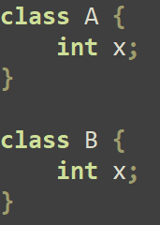
Identification Cache
Identifier “x” only makes sense in context.
Even if two identifiers’ underlying text is the same, the declaration can be different when appearing in different parts of the code.
Both use “x” as the identifier, but can only tell them apart in context.
COMP 520: Compilers – S. Ali

Slide 49
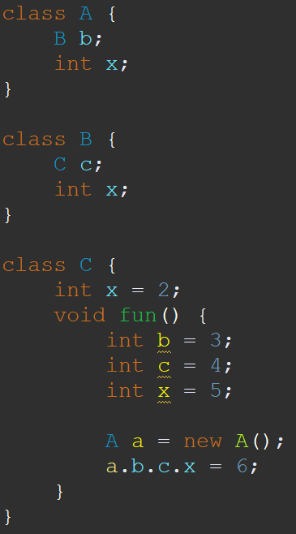
Left-most Reference
Only the left-most reference should be resolved normally (start at the top of the SI stack, then work down).
Once you know the Declaration of the left-most reference, you have a context.
COMP 520: Compilers – S. Ali

Slide 50
Left-most Reference
QualRef(LHS,RHS): LHS is a Reference, and RHS is an Identifier.
With the type of the LHS (the context), resolve the RHS.
a.b means “.b” is resolved in the context of the type of “a”, which is class “A”.
COMP 520: Compilers – S. Ali

Slide 51
Left-most Reference
With the type of the LHS (the context), resolve the RHS.
Note: this means that you can bypass local variables.
“a.b.c.x” but “b”, “c”, “x” were all locally defined.
COMP 520: Compilers – S. Ali

Slide 52
QualRef Strategy
Try to get the “context” by visiting the LHS reference.
With that context, resolve the RHS.
E.g. “a.b” will return the context of class “B”, thus allowing resolution of “a.b.c” where “c” is in the context of “B”
COMP 520: Compilers – S. Ali

Slide 53
No one strategy dominates all others
How you choose to identify “context” is up to you. It can be a String, ClassDecl, TypeDenoter, etc.
Even more important to plan PA3 than other assignments before starting to code.
If you change your Visitor’s parameter or return type, you may have to redo the entire class declaration!
COMP 520: Compilers – S. Ali

Slide 54
Other Contextual Constraints
COMP 520: Compilers – S. Ali

Slide 55
Contextual Analysis
There are contextual parts of Java (and miniJava) that do not quite fit Identification or Type Checking.
We can easily implement these as a part of either.
COMP 520: Compilers – S. Ali

Slide 56
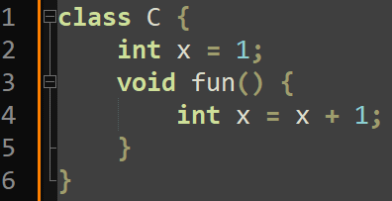
Contextual Analysis (2)
If an identifier is being declared, then it cannot be used in the expression.
Even if the expression can be evaluated first!
Not allowed!
COMP 520: Compilers – S. Ali

Slide 57
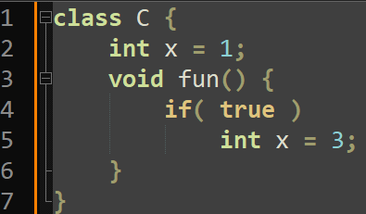
Contextual Analysis (3)
You cannot have a variable declaration only in a scope to itself.
A BlockStmt (new scope) is necessary for VarDeclStmt.
Not allowed!
COMP 520: Compilers – S. Ali

Slide 58
End

Slide 59
COMP 520: Compilers – S. Ali

Slide 60
COMP 520: Compilers – S. Ali

Slide 61
COMP 520: Compilers – S. Ali

Slide 62
COMP 520: Compilers – S. Ali

